Slide 1
Comprehensive VHDL Hamdi Abdelbagi Phone: (937) 830-7761 Email: abdelbagih1@udayton.edu

Slide 2
Synthesising Combinational Logic
Aim
How to synthesise arithmetic using vector
Topics covered
Arithmetic operator overloading
Arithmetic package – numeric_std
Mixing integers and vectors
Resizing vectors
Resource sharing

Slide 3
Arithmetic operators

Slide 4
Operator Overloading

Slide 5
Using NUMERIC_STD

Slide 6
Shift and Rotate Operators

Slide 7
Shifting std_logic_vector

Slide 8
Conversion functions

Slide 9
Array type conversion

Slide 10
Numeric_std and std_logic_vector

Slide 11
Conversions

Slide 12
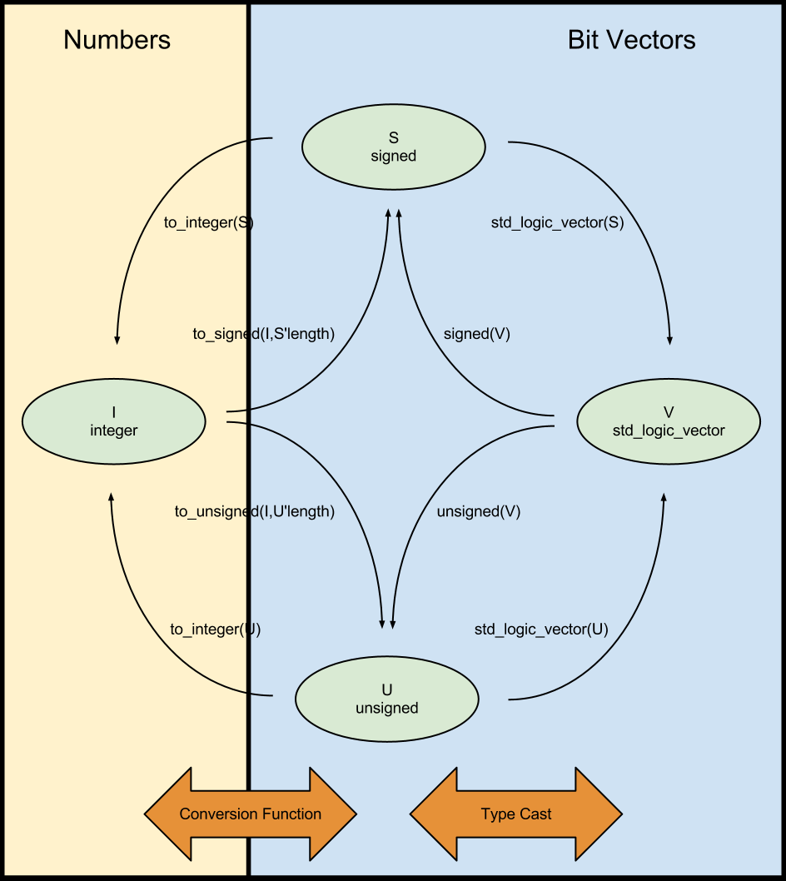
Conversions

Slide 13
Summary of numeric_std

Slide 14
Quiz 1

Slide 15
Quiz 2

Slide 16
Vector arithmetic

Slide 17
Sign Extension

Slide 18
Resource sharing

Slide 19
Manual Resource Sharing

Slide 20
Legacy packages

Slide 21
Synthesising Sequential logic
Aim
To understand the use of the VHDL in modeling and synthesizing sequential logic, i.e. circuit containing clocks and registers
Topics covered
RISING_EDGE
Asynchronous set or reset
Synchronous inputs and clock enable
Synthesisable process templates
Implying register

Slide 22
RISING_EDGE
RISING_EDGE is TRUE when clock changes from ‘0’ or ‘L’ to ‘1’ or ‘H’

Slide 23
Asynchronous Set or Reset

Slide 24
Synchronous vs Asynchronous Action

Slide 25
Clock Enables

Slide 26
Synthesisable Process template

Slide 27
Synthesis Tool Architecture

Slide 28
RTL Synthesis

Slide 29
Implying Registers

Slide 30
No Register Optimization

Slide 31
Using QBAR

